Slide 1
Graphalgorithmen
Oliver Brock
Robotics and Biology Laboratory

Slide 2
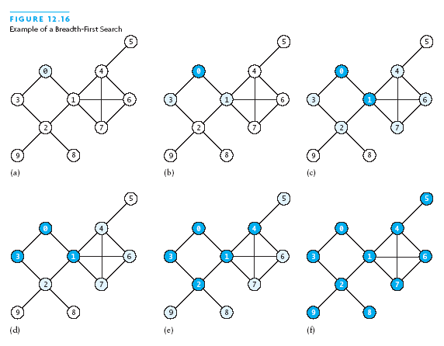
Breadth-First Search (BFS)

Slide 3
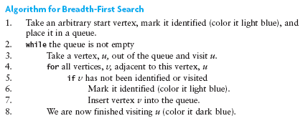
Algorithm for Breadth-First Search

Slide 4
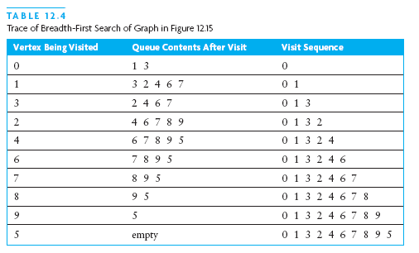
Algorithm for Breadth-First Search (continued)

Slide 5
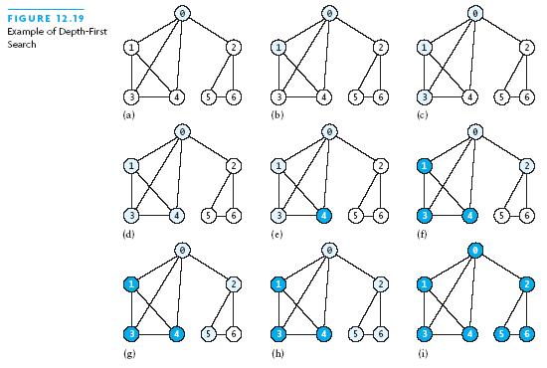
Depth-First Search (DFS)

Slide 6
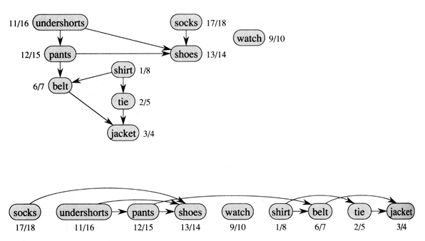
Topological Sorting (Getting Dressed)
Notes:
https://en.wikipedia.org/wiki/Topological_sorting
The canonical application of topological sorting (topological order) is in scheduling a sequence of jobs or tasks based on their dependencies; topological sorting algorithms were first studied in the early 1960s in the context of the PERT technique for scheduling in project management (Jarnagin 1960). The jobs are represented by vertices, and there is an edge from x to y if job x must be completed before job y can be started (for example, when washing clothes, the washing machine must finish before we put the clothes in the dryer). Then, a topological sort gives an order in which to perform the jobs.
In computer science, applications of this type arise in instruction scheduling, ordering of formula cell evaluation when recomputing formula values in spreadsheets, logic synthesis, determining the order of compilation tasks to perform in makefiles, data serialization, and resolving symbol dependencies in linkers. It is also used to decide in which order to load tables with foreign keys in databases.

Slide 7
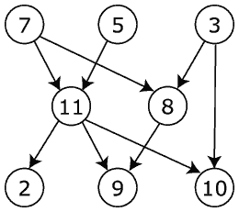
Topological Sort
7, 5, 3, 11, 8, 2, 9, 10 (visual left-to-right, top-to-bottom)
3, 5, 7, 8, 11, 2, 9, 10 (smallest-numbered available vertex first)
3, 7, 8, 5, 11, 10, 2, 9
5, 7, 3, 8, 11, 10, 9, 2 (fewest edges first)
7, 5, 11, 3, 10, 8, 9, 2 (largest-numbered available vertex first)
7, 5, 11, 2, 3, 8, 9, 10
http://en.wikipedia.org/wiki/Topological_sorting

Slide 8
Dijkstra’s Algorithm
E.W. Dijkstra, A Note on Two Problems in Connection with Graphs, Numerische Mathematik, Vol. 1, pages 269-271, 1959
Single-source shortest-path problem
Weighted (only positive weights), directed graph G(V,E)
Given a node n 2 N, what is the shortest path to all other reachable nodes?
http://optlab-server.sce.carleton.ca/POAnimations2007/DijkstrasAlgo.html

Slide 9
Dijkstra cont.
e₂
1
e₃
10
2
3
9
S
e₁
4
6
5
7
e₄
e₅
2

Slide 10
Dijkstra Initialization
1
1
e₂
1
e₃
10
0
9
2
3
S
e₁
4
6
5
7
e₄
1
e₅
1
2
Current nodes:
{e₁=0, e₂=1, e₃=1, e₄=1, e₅=1}
Nodes completed:
{;}

Slide 11
Dijkstra Relaxation 1
1
1
10
1
e₂
e₃
10
0
9
2
3
S
e₁
4
6
5
7
e₄
1
e₅
1
5
2
{e₁=0, e₂=1, e₃=1, e₄=1, e₅=1}
Current nodes:
{e₄=5, e₂=10, e₃=1, e₅=1}
{e₁}
Nodes completed:
{;}

Slide 12
Dijkstra Relaxation 2
8
1
10
1
14
e₂
e₃
10
0
9
2
3
S
e₁
4
6
5
7
e₄
e₅
1
5
7
2
{e₅=7, e₂=8, e₃=14}
Current nodes:
{e₄=5, e₂=10, e₃=1, e₅=1}
{e₁}
Nodes completed:
{e₁,e₄}

Slide 13
Dijkstra Relaxation 3
8
13
e₂
1
e₃
14
10
0
9
2
3
S
e₁
4
6
5
7
e₄
e₅
7
5
2
{e₅=7, e₂=8, e₃=14}
Current nodes:
{e₂=8, e₃=13}
{e₁,e₄}
Nodes completed:
{e₁,e₄,e₅}

Slide 14
Dijkstra Relaxation 4
8
9
e₂
1
e₃
13
10
0
9
2
3
S
e₁
4
6
5
7
e₄
e₅
7
5
2
{e₂=8, e₃=13}
Current nodes:
{e₃=9}
{e₁,e₄,e₅}
Nodes completed:
{e₁,e₂,e₄,e₅}

Slide 15
Dijkstra Relaxation 5
8
1
9
e₂
e₃
10
0
9
2
3
S
e₁
4
6
5
7
e₄
e₅
7
5
2
{e₃=9}
Current nodes:
{}
{e₁,e₂,e₄,e₅}
Nodes completed:
{e₁,e₂,e₃,e₄,e₅}

Slide 16
Relaxation
Gegeben sei ein Graph G= (V,E) mit Kantengewicht c (u,v) und einem Ausgangsknoten v₀.
Dann gilt für alle Kanten (u,v) : d (v₀,v) ≤ d (v₀,u) + c (u,v)
Relaxation
d(v₀,u)
u
v₀
c(u,v)
v
d(v₀,v)
Gummiband
Gummiband entspannt sich
(Relaxation)
Zapfen wird entfernt

Slide 17
Dijkstra cont. III
Dijkstra(G,w,s)
Initialize-Single-Source(G,s)
S Ã ; // explored vertices
Q Ã V[G] // Q is a priority queue; to be explored: all
while Q ≠ 0 // while queue is not empty
do u Ã Extract-Min(Q)
S Ã S [ {u} // add to explored vertices
for each vertex v 2 Adj[u] // for all adjacent vertices do Relax (u,v,w)
Intialize-Single-Source(G,s)
for each vertex v 2 V[G]
do d[v]Ã 1
π[v] Ã NIL
d[s] Ã 0
Relax(u,v,w)
//Is it shorter to reach v via u?
if d[v] > d[u] + w(u,v)
then d[v] Ã d[u] + w(u,v)
π[v] Ã u

Slide 18
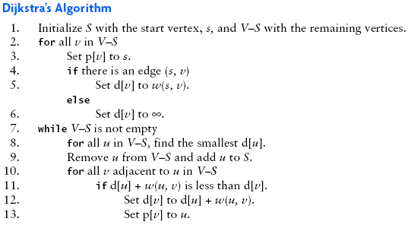
Nochmal Dijkstra’s shortest path algorithm

Slide 19
Nochmal Dijkstra
1 function Dijkstra(Graph, source):
2 for each vertex v in Graph: // Initializations
3 dist[v] := infinity ; // Unknown distance function from source to v
4 previous[v] := undefined ; // Previous node in optimal path from source
5 end for ;
6 dist[source] := 0 ; // Distance from source to source
7 Q := the set of all nodes in Graph ;
// All nodes in the graph are unoptimized - thus are in Q
8 while Q is not empty: // The main loop
9 u := vertex in Q with smallest dist[] ;
10 if dist[u] = infinity:
11 break ; // cannot reach remaining vertices from source
12 end if ;
13 remove u from Q ;
14 for each neighbor v of u: // where v has not yet been removed from Q.
15 alt := dist[u] + dist_between(u, v) ;
16 if alt < dist[v]: // Relax (u,v,a)
17 dist[v] := alt ;
18 previous[v] := u ;
19 decrease-key v in Q; // Reorder v in the Queue
20 end if ;
21 end for ;
22 end while ;
23 return dist[] ;
24 end Dijkstra.
Notes:
From: http://en.wikipedia.org/wiki/Dijkstra%27s_algorithm

Slide 20
Bellman-Ford Algorithmus
procedure BellmanFord(list vertices, list edges, vertex source)
// This implementation takes in a graph, represented as lists of vertices
// and edges, and modifies the vertices so that their distance and
// predecessor attributes store the shortest paths.
// Step 1: initialize graph
for each vertex v in vertices:
if v is source then v.distance := 0
else v.distance := infinity
v.predecessor := null
// Step 2: relax edges repeatedly
for i from 1 to size(vertices)-1:
for each edge uv in edges: // uv is the edge from u to v
u := uv.source
v := uv.destination
if u.distance + uv.weight < v.distance:
v.distance := u.distance + uv.weight
v.predecessor := u
// Step 3: check for negative-weight cycles
for each edge uv in edges:
u := uv.source
v := uv.destination
if u.distance + uv.weight < v.distance:
error "Graph contains a negative-weight cycle"
Notes:
From: http://en.wikipedia.org/wiki/Bellman–Ford_algorithm

Slide 21
Bellman-Ford Algorithmus
function BellmanFord(list vertices, list edges, vertex source)
::distance[],predecessor[]
// This implementation takes in a graph, represented as
// lists of vertices and edges, and fills two arrays
// (distance and predecessor) with shortest-path
// (less cost/distance/metric) information
// Step 1: initialize graph
for each vertex v in vertices:
distance[v] := inf // At the beginning , all vertices have a weight of infinity
predecessor[v] := null // And a null predecessor
distance[source] := 0 // Except for the Source, where the Weight is zero
// Step 2: relax edges repeatedly
for i from 1 to size(vertices)-1:
for each edge (u, v) with weight w in edges:
if distance[u] + w < distance[v]:
distance[v] := distance[u] + w
predecessor[v] := u
// Step 3: check for negative-weight cycles
for each edge (u, v) with weight w in edges:
if distance[u] + w < distance[v]:
error "Graph contains a negative-weight cycle"
return distance[], predecessor[]
Notes:
https://en.wikipedia.org/wiki/Bellman%E2%80%93Ford_algorithm

Slide 22

Floyd Warshall

Slide 23
Floyd Warshall
1 /* Assume function edgeCost(i,j) which returns cost of edge ij
2 (infinity if there is none).
3 Also assume that n is number of vertices and edgeCost(i,i) = 0
4 */
5
6 int path[][];
7 /* A 2-dimensional matrix. At each step in the algorithm, 8 path[i][j] is the shortest path from i to j using 9 intermediate vertices (1..k−1). Each path[i][j] is
10 initialized to edgeCost(i,j).
11 */
12
13 procedure FloydWarshall ()
14 for k := 1 to n
15 for i := 1 to n
16 for j := 1 to n
17 path[i][j] = min( path[i][j], path[i][k]+path[k][j] );
Notes:
From: http://en.wikipedia.org/wiki/Bellman–Ford_algorithm

Slide 24
Floyd Warshall mit Wegausgabe
1 procedure FloydWarshallWithPathReconstruction ()
2 for k := 1 to n
3 for i := 1 to n
4 for j := 1 to n
5 if path[i][k] + path[k][j] < path[i][j] then
6 path[i][j] := path[i][k]+path[k][j];
7 next[i][j] := k;
8
9 procedure GetPath (i,j)
10 if path[i][j] equals infinity then
11 return "no path";
12 int intermediate := next[i][j];
13 if intermediate equals 'null' then
14 return " "; /* direct edge exists */
15 else
16 return GetPath(i,intermediate) + intermediate + GetPath(intermediate,j);
Notes:
From: http://en.wikipedia.org/wiki/Bellman–Ford_algorithm

Slide 25
Zusammenfassung
BFS, DFS: eine Quelle, alle Senken, Pfade werden gefunden aber ohne Qualitätszusage
Dijkstra: eine Quelle, alle Senken, kürzeste Pfade, nur positive Kantengewichte
Bellman Ford: eine Quelle, alle Senken, kürzeste Pfade, auch negative Kantengewichte
Floyd Warshal: alle Quellen, alle Senken, kürzeste Pfade, auch negative Kantengewichte
A*: eine Quelle, eine Senke, kürzeste Pfade, wenn die Heuristik konservativ ist

